Slide 1
How would you define perseverance?
What do you think perseverance looks like?

Slide 2
Perseverance
Perseverance involves the voluntary continuation of a goal-directed action despite the presence of challenges, difficulties, and discouragement. There are two vectors of perseverance. It requires both effort for a task and duration to keep the task up. (ViaCharacter.org)
continued effort to do or achieve something despite difficulties, failure, or opposition : the action or condition or an instance of persevering : steadfastness (Merrian -Webster Dictionary)

Slide 3
Perseverance can be seen in the larger virtue category of Courage. Courage describes strengths that deal with overcoming fear. These strengths can manifest themselves inwardly or outwardly as they are composed of cognitions, emotions, motivations and decisions.
Definition from ViaCharacter.org

Slide 4
Titan Creed
Titan’s endeavor to…
Striving to be our best, do our best, and give our best to the world

Slide 5
A glimpse of perseverance
Here is a short video clip that shows courage, bravery, and perseverance in action. It is of Billy Matthews, an 8-year-old with cerebral palsy that is running with a walker in the final leg of a triathlon in the United Kingdom. Billy challenged himself in this triathlon to complete a 100-meter lake swim, a 4,000-meter bike ride and a 1,300-meter run, according to the Facebook page. This would be incredibly difficult for someone with cerebral palsy.

Slide 6
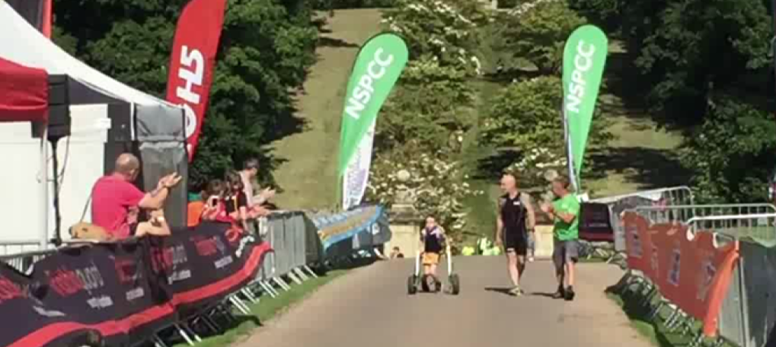
LINK TO YouTube

Slide 7
Questions to think through Perseverance
Do you think it was easy for Billy to leave the safety of his walker?
Would it be difficult to get up after falling once? After the second time?
What would drive him to get up twice and keep running to the finish?
It is easy for you to show perseverance through difficult times?
What ways have you demonstrated perseverance in the past?
What are some ways that we can live out perseverance at school?
What are some ways that we can live out perseverance outside of school?
Who is someone that you feel has modeled perseverance for you?
Why would the character trait of perseverance be important to living a life characterized by character?

Slide 8
Practical Ideas to developing perseverance
Set five small goals weekly. Break them into practical steps, accomplish them on time, and monitor your progress from week to week.
Keep a checklist of things to do and regularly update it.
Select a role-model who exemplifies perseverance and determine how you can follow her/his footsteps.
What other things could you do to develop the habit of perseverance in your daily life?
From Viacharacter.org

